Slide 1
Introduction to Data Analysis using Python
Yongqi Pang

Slide 2
Introduction to Data Analysis using Python
Basic explanation: Why python matters
List all the packages we use:
Numpy
Pandas
Matplotlib
seaborn
Insert some codes for each method and explain it
Applications of Data Analysis using Python for Covid-19

Slide 3
Why python for Data Analysis?
Python is an object-oriented, high-level and extremely interpreted programming language.
Python is known worldwide for its immense capabilities of Rapid Application Development, especially because of dynamic binding and typing.
Python is also used extensively for scripting, and it is even used as a glue language to link the present existing components together.
Python is quick, and there are many libraries that make Python more preferred as well, like Matplotlib.
With the help of Python, the engineers are able to use less lines of code to complete the tasks.

Slide 4
Packages we used for this project the most
NumPy: NumPy is a general-purpose array-processing package. It provides a high-performance multidimensional array object, and tools for working with these arrays.
Pandas: Pandas is used for data manipulation, analysis and cleaning.
Matplotlib: Matplotlib is a multi-platform data visualization library built on NumPy arrays and designed to work with the broader SciPy stack.
Seaborn: Seaborn is a library for making statistical graphics in Python. It is built on top of matplotlib and closely integrated with Pandas data structures.
Notes:
-- NumPy contains various features including these important ones: A powerful N-dimensional array object
Sophisticated (broadcasting) functions
Tools for integrating C/C++ and Fortran code
Useful linear algebra, Fourier transform, and random number capabilities
---Python pandas is well suited for different kinds of data, such as:
Tabular data with heterogeneously-typed columns
Ordered and unordered time series data
Arbitrary matrix data with row & column labels
Unlabelled data
Any other form of observational or statistical data sets
---Matplotlib: It provides an object-oriented API for embedding plots into applications using general-purpose GUI toolkits like Tkinter, wxPython, Qt, or GTK+
---Seaborn: Seaborn aims to make visualization a central part of exploring and understanding data. Its dataset-oriented plotting functions operate on dataframes and arrays containing whole datasets and internally perform the necessary semantic mapping and statistical aggregation to produce informative plots.
some of the functionality that seaborn offers:
A dataset-oriented API for examining relationships between multiple variables
Specialized support for using categorical variables to show observations or aggregate statistics
Options for visualizing univariate or bivariate distributions and for comparing them between subsets of data
Automatic estimation and plotting of linear regression models for different kinds dependent variables
Convenient views onto the overall structure of complex datasets
High-level abstractions for structuring multi-plot grids that let you easily build complex visualizations
Concise control over matplotlib figure styling with several built-in themes
Tools for choosing color palettes that faithfully reveal patterns in your data

Slide 5
Simple Examples:
Numpy
Pandas
Matplotlib
Seaborn
#import package
import numpy as np
#provide data
data = [[1, 2, 3, 4], [5, 6, 7, 8]]
#converting input data into an ndarray
mymat = np.array(data)
mymat.T.dot(mymat)
#import package
import pandas as pd
data = {"office": ["11.130", "11.126", "11.134"], "people": [3, 2, 0], "area": [1000, 2, 3]}
#construct a DataFrame
df = pd.DataFrame(data, index=[”One", ”Two", ”Three"])
#the resulting DataFrame
df[df['area'] > 2]
#import package
import pandas as pd
import numpy as np
import matplotlib.pyplot as plt
#set data and plot data, a simple line plot will be displayed
data = np.arrange(10)
plt.plot(data)
#import package
import seaborn as sns
#read files
example=pd.read_csv(“data.csv”)
#set data and plot data, a seaborn regression plot will be displayed
data=example[[“cp1”,”m1”,tbilrate”,”unemp”]]
trans_data=np.log(data).diff().dropna()
plot=sns.regplot(“m1”,”unemp”,data=trans_data)
Notes:
McKinney, Wes. Python for Data Analysis : Data Wrangling with Pandas, NumPy, and IPython / Wes McKinney. Second edition. Beijing: O’Reilly, 2017. Print.

Slide 6
Links
This is the link of google Colab file which contains all the codes that I have wrote: https://colab.research.google.com/drive/1J3sEwiGilhsKXU9H1J_ZBFwNJazZvN1H
Please check it out for details.

Slide 7
Applications of Data Analysis using Python for Covid-19: Summary from Colab
The case of Travis County
Log Scaling for “Confirmed” cases
Log Scaling for “Deaths” cases

Slide 8
Continued
Seaborn regression plot of the change for the "Confirmed” cases over time
Confirmed: Log scaling
Dates: from 3/13-4/25

Slide 9
SIR Model : Variables & Parameters
The meaning of this model
Visualize the meaning of the model
Define the variables and parameters
Some Calculations
How to model it using python

Slide 10
What is SIR model
Susceptible is a group of people who are vulnerable to exposure with infectious people. They can be patients when the infection happens.
Infectious is a group of people who are infected. They can pass the disease to the susceptible people and can be recovered in a specific period.
Recovered represents the group of people who get immunity so that they are not susceptible to the same illness anymore.
SIR model is a kind of compartmental model describing the dynamics of infection disease. The model divides the population into compartments, Each compartments is expected to have same characteristics. SIR represents the three compartments segmented by the model.
S~ Susceptible
I~ Infectious
R~ Recovered

Slide 11
SIR Model: Chart
The relationships among these three groups of people are show as the chart below:
SIR model is a framework describing the number of people in each group can change over time.
SIR model allows us to describe the number of people in each compartment with the ordinary differential equation.
$$Total population⟹N=S+I+R$$

Slide 12
Parameters and equations
$\frac{dS}{dt}$ = $−βIS$
$\frac{dI}{dt}$ = $βIS−γI$
$\frac{dR}{dt}$ = $γI$
$β$ is a parameter controlling how much the disease can be transmitted through exposure. It is determined by the chance of contact and the probability of disease transmission.
$γ$is a parameter expressing how much the disease can be recovered in a specific period. Once the people are healed, they get immunity. There is no chance for them to go back susceptible again.
Note: we do not consider the effect of the natural death or birth rate because the model assumes the outstanding period of the disease is much shorter than the lifetime of the human.

Slide 13
Calculations
Suppose $𝒟 \text{is} \text{the} \text{average} \text{days} \text{to} \text{recover} \text{from} \text{infectious}\text{,}$ derived from $γ$, we have,
$$𝒟= \frac{1}{γ}$$
We can also estimate the nature of the disease in terms of the power of infection.
$$R_{0}=\frac{β}{γ}$$
It is called a basic reproduction number.

Slide 14
Basic Reproduction Number
$R_{0}$ is the average number of people infected from one other person. If it is high, the probability of pandemic is also higher which it also means that it is harder to control the epidemic.
𝑅_0 is the average number of people infected from one other person. If it is high, the probability of pandemic is also higher which it also means that it is harder to control the epidemic.
If $R_{0}>1$ : the infection will be able to start spreading in a population and will be exponentially distributed, and soon to be epidemic.
If 𝑅_0>1 : the infection will be able to start spreading in a population and will be exponentially distributed, and soon to be epidemic.
If $R_{0}<1$ : it will not be epidemic.
If 𝑅_0<1 : it will not be epidemic.
If $R_{0}=1$ : it will become the endemic disease.
If 𝑅_0=1 : it will become the endemic disease.

Slide 15
Continued
$R_{0}$ is also used to estimate the herd immune threshold (HIT).
If the basic reproduction number multiplied by the percentage of susceptible is equal to 1, it indicates the balanced state. The number of infectious people is constant. Suppose the proportion of immune people is $p$, then we have,
$$R_{0}\left(1−p\right)=1$$
$1−p=\frac{1}{R_{0}}$
$p_{c}=1−\frac{1}{R_{0} }$
Note: $p_{c}$ is the HIT to stop the spread of the infectious disease. We can stop the outbreak by vaccinating the population to increase herd immunity.

Slide 16
Running the model through python
It is important to know the values of $β$ and $γ$.
When beta =0.21, gamma=0.0529
When beta = 0.21, gamma = 0.00529

Slide 17
Conclusion
When gamma is smaller, the graph on the right shows that recovered rate is much lower than the recovered rate on the left graph.
When the gamma is smaller, the infection rate of right graph is on a higher peak.
When gamma is smaller, the days we use to stop the pandemic is longer.

Slide 18
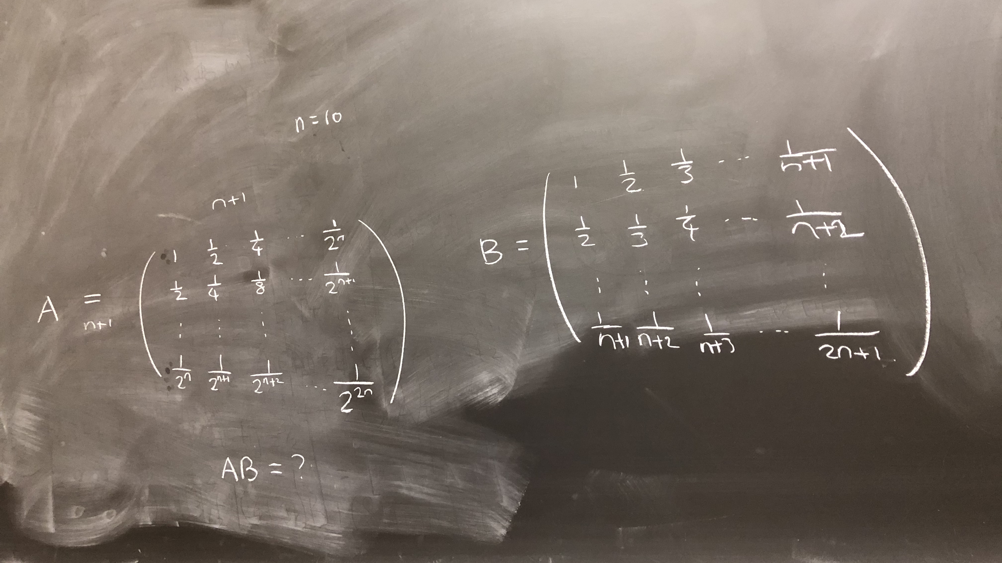
Extra information
My Practice problem for NumPy package study

Slide 19
Reference
McKinney, Wes. Python for Data Analysis : Data Wrangling with Pandas, NumPy, and IPython / Wes McKinney. Second edition. Beijing: O’Reilly, 2017. Print.

